Slide 1
Spectrochip-VII Processor
Release 8.0 User Guide
1
Version 1.00
Adrian Tang © UCLA/JPL 2018

Slide 2
Contents
Hardware Configuration
PCB Overview …………………..1
Useful test signals……………..7
Calibration Principles………..9
Readout Configuration…….12
Arduino Configuration……..16
Software and configuration
Basic Utilities list………………….22
Cal Config File..…………………….26
SVII_CAL utility…………………….30
SVII_lock utility…………………….33
SVII_align utility…………………….35
SVII_analog utility………………...37
Final Thoughts………………………40
Environment/Driver Configuration
Interface Architecture………….19
Linux Environment………………20
Udev kernel and SNs..………….21
2
Version 1.00
Adrian Tang © UCLA/JPL 2018

Slide 3
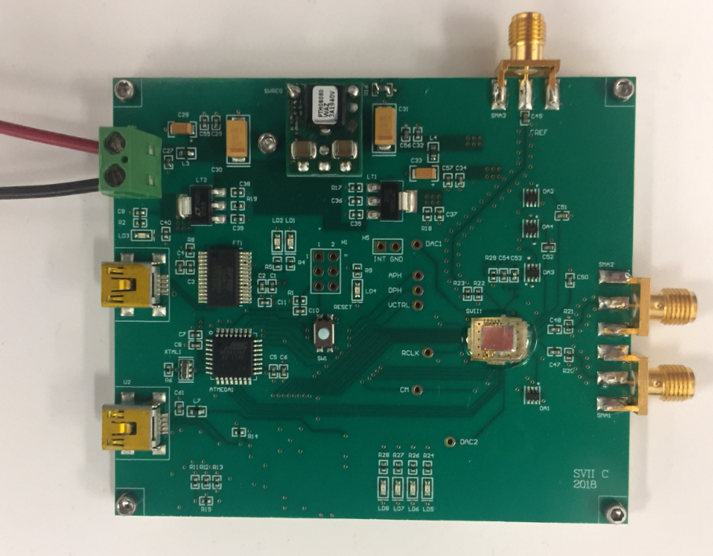
SVII – Revision C PCB Module
CLK
The new board runs off an external 5V
supply provided at the green terminal.
The pin away from the USB is 5V the
Pin near the USB is ground.
The clock port accepts a clock signal up
to 0 dBm in the range of 0 to 3 GHz.
Under normal conditions the clock is
23.4375 MHz (3GHz/128)
+5V
1
GND
3
SIG+
2
SIG-
New features include
DC-DC power supply allows the 1.2V chip core power to be generated with less heat
Higher speed USB 2.0 Readout
More advanced Arduino/Atmel platform making use of the analog ADC inputs
3
Version 1.00
Adrian Tang © UCLA/JPL 2018

Slide 4
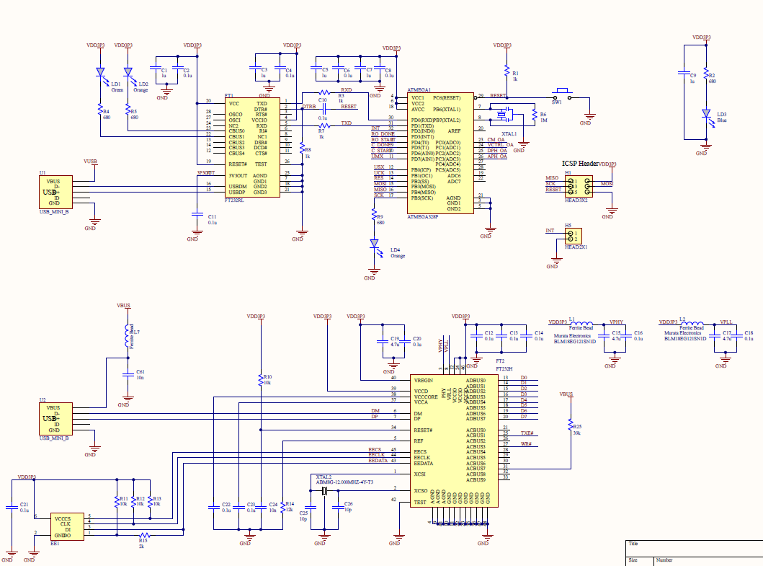
SVII – Revision C PCB Module
Arduino Platform
High speed USB2.0 readout
Readout config EEPROM
4
Version 1.00
Adrian Tang © UCLA/JPL 2018

Slide 5
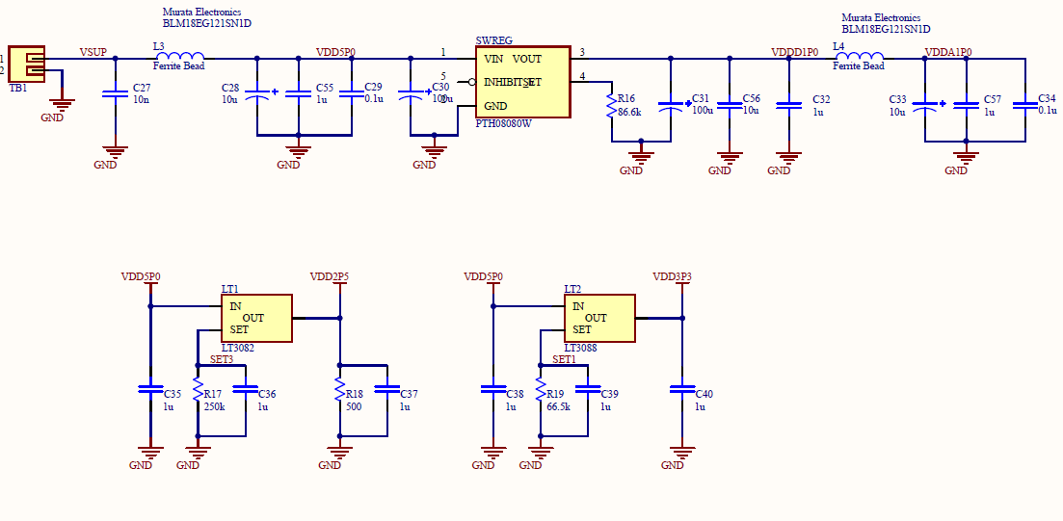
SVII – Revision C PCB Module
Core Power via DC-DC Converter
I/O Power is regulated
5
Version 1.00
Adrian Tang © UCLA/JPL 2018

Slide 6
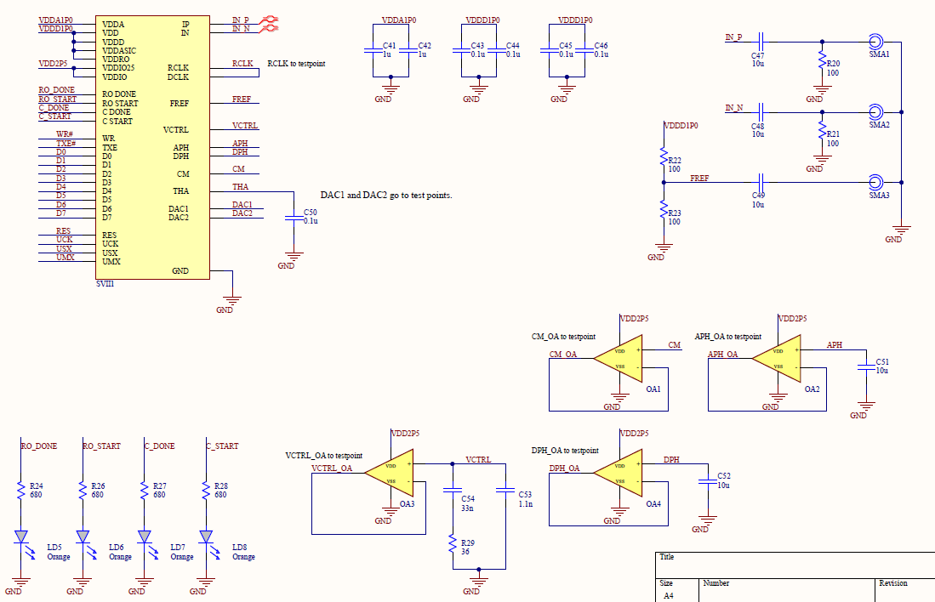
SVII – Revision C PCB Module
Internal SVII Sensor Network is
Buffered back to arduino ADC
6
Version 1.00
Adrian Tang © UCLA/JPL 2018

Slide 7
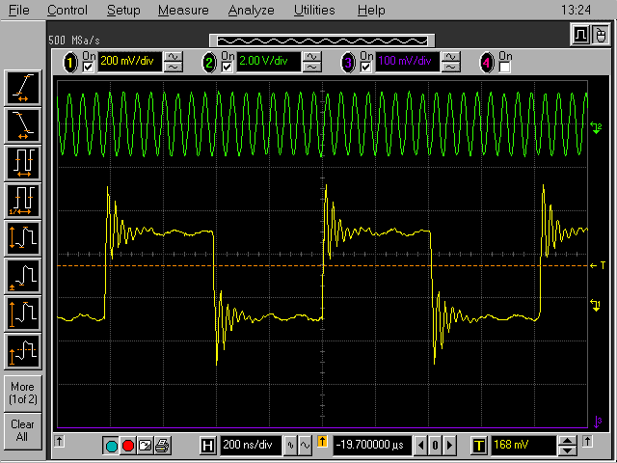
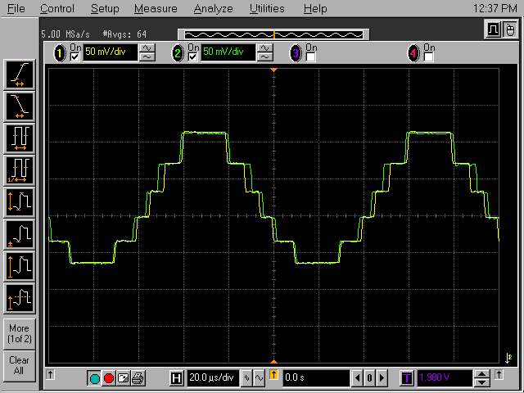
SVII – C Clock/Data Test Signals
Readout Clock Monitor
ADC Status Monitor
ADC Status monitor shows quality of ADC calibration
Readout clock rate is software programmable
7
Version 1.00
Adrian Tang © UCLA/JPL 2018

Slide 8
SVII – C Clock/Data Test Signals
Internal Synthesizer Status
100mV to 1100mV Locked
Outside this range: not locked
Processor Status Monitor
Idle
Acquire
Acq done
(ready to readout)
Readout Running
Readout Complete
ADC Status monitor shows quality of ADC calibration
Readout clock rate is software programmable
8
Version 1.00
Adrian Tang © UCLA/JPL 2018

Slide 9
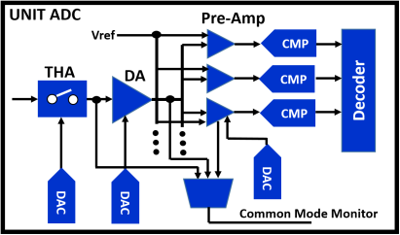
SVII – C Analog Calibration Principles
We include an extra ADC called a “Replica” which is an exact duplicate of the real ADCs except no IF input signal is applied.
We monitor the DC conditions of the replica and digitally adjust all 3 ADCs, with the same digital DC settings in closed loop, allowing us to optimize conditions in the ADC while it’s running.
The Vref for each flash ADC level is generated dynamically with a set of 7 8-bit DACs. Allows INL and DNL to be calibrated on the fly also.
The cal sub-processor is implemented on the arduino using it’s ADC pins to read the ADC conditions and settings are applied through the USART path. A mux inside the chip selects what signal is steered to the CM pin out to the arduino ADC. The CM pin itself has a test point that will show the voltage of whatever is currently connected.
Vref
gen
8b DAC
8b DAC
8b DAC
vref
UNIT
ADC1
IF
Input
data
vref
UNIT
ADC2
data
DC control
Calibration
Sub
Processor
REP
ADC
Closed loop
TERM
AUX
ADC
DC monitoring
9
Version 1.00
Adrian Tang © UCLA/JPL 2018

Slide 10
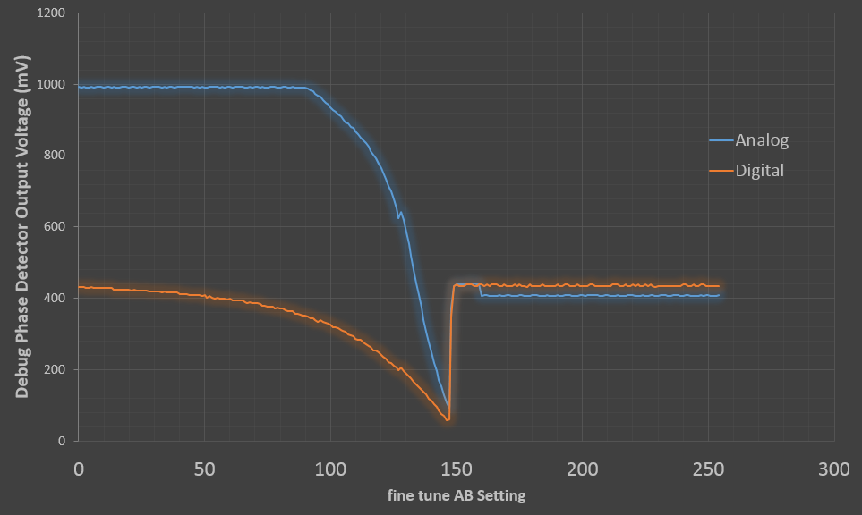
SVII – C Coarse Clock Calibration
Prog Phase 0-360º
DIV 4
Prog Phase 0-360º
DIV 4
Prog Phase 0-360º
Prog Phase 0-360º
DIV 4
Prog Phase 0-360º
DIV 4
Prog Phase 0-360º
Closed Loop
Forces these
to 12.5º
Closed Loop
Forces these
to 45º
Phase
dect
Phase
dect
Phase
dect
Closed Loop
Forces these to 180º
Calibration Sub-Processor
AUX
ADC
Clock system contains phase detectors between key points which the calibration sub-processor uses to automatically set the digital phase shifters and align the clock edges in the data path and processor core.
The software to do this runs on the arduino and uses it’s ADC to read the phase detectors (again selected by on chip muxes to the APH and DPH pins) that are read by the arduino ADC.
Example Clock Alignment Sequence
10
Version 1.00
Adrian Tang © UCLA/JPL 2018

Slide 11
SVII – C Coarse Clock Calibration
Coarse clock settings of the main A and B clocks are tuned with the phase detectors but fine tuning at each stage is done in software, considering the spectrum for each setting and selecting the best possible setting.
This is because the phase detector is too coarse to resolve the sub-degree percision required to avoid any spurs.
This will be described more later on in the software section.
11
Version 1.00
Adrian Tang © UCLA/JPL 2018

Slide 12
SVII – C Readout Configuration
The readout now uses the FT23H high speed USB2.0 chip. The chip offers 4 input modes (serial, latched, synchronous, or IEEE 245 mode). We use the 245 mode, but it’s not the default factor setting so we have a small EEPROM on the PCB that needs to be flashed in order to correct this.
The utility to do the programming is FT_PROG from the FTDI website
(http://www.ftdichip.com/Support/Utilities.htm#FT_PROG)
12
Version 1.00
Adrian Tang © UCLA/JPL 2018

Slide 13
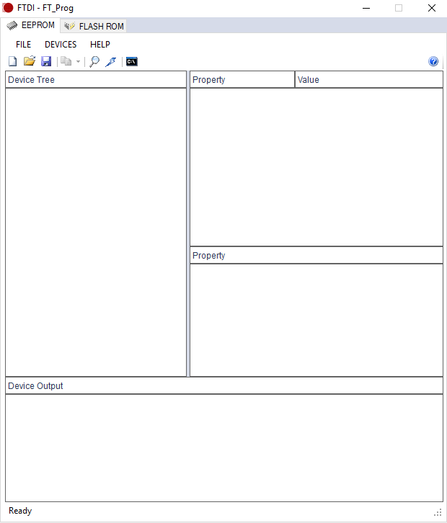
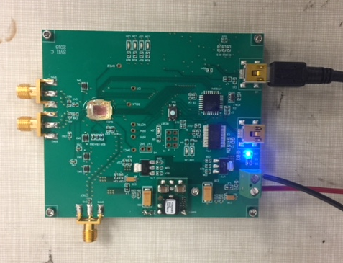
SVII – C Readout Configuration
Apply 5V power to the SVII board and connect a USB to the data port (but not the control port or you may flash the wrong chip!)
Run the FT_PROG utility
Click the scan button.
13
Version 1.00
Adrian Tang © UCLA/JPL 2018

Slide 14
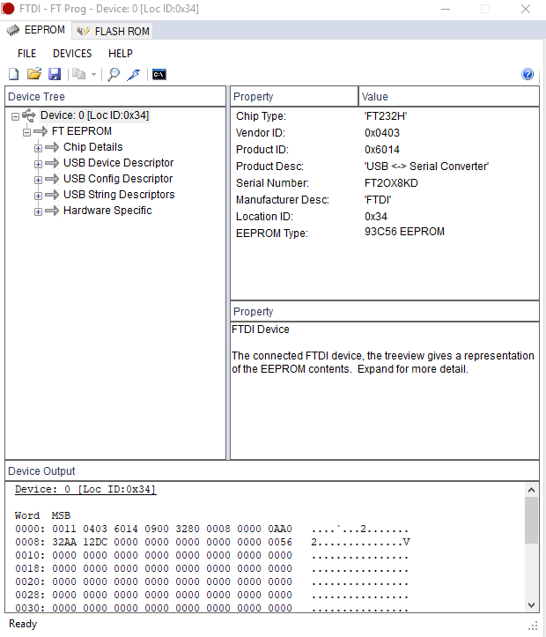
SVII – C Readout Configuration
If you did it right, a chip should be detected with some content already in the EEPROM chip.
If it didn’t work check windows permissions and all the usual stuff.
To set 245 mode:
on the device tree navigate to
“Hardware Specific”
“Port A”
“Hardware”
and change the option from ” RS232 UART”
to “245 FIFO”
14
Version 1.00
Adrian Tang © UCLA/JPL 2018

Slide 15
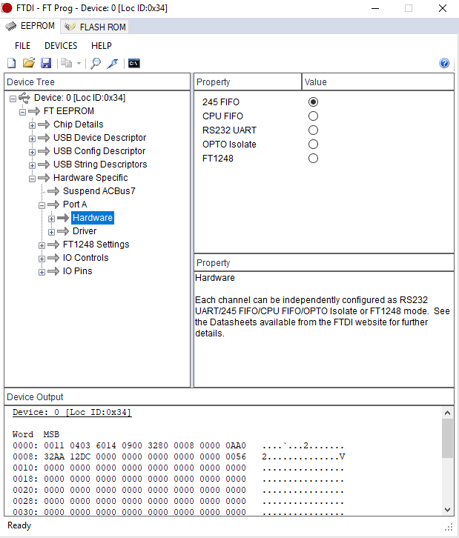
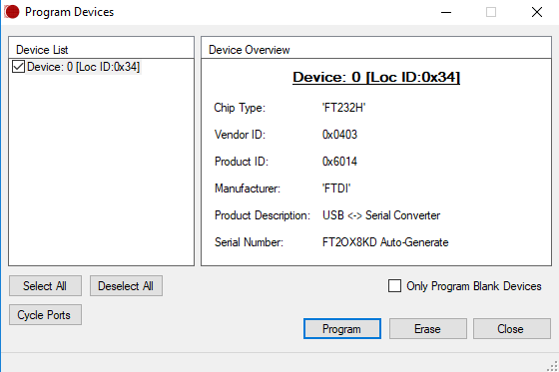
SVII – C Readout Configuration
Click program and a sub-window should pop up with program options
Click program in this window and it should update the chip and say programmed successfully
As verification it went in. if you read the device again the 245 FIFO mode should be selected this time.
15
Version 1.00
Adrian Tang © UCLA/JPL 2018

Slide 16
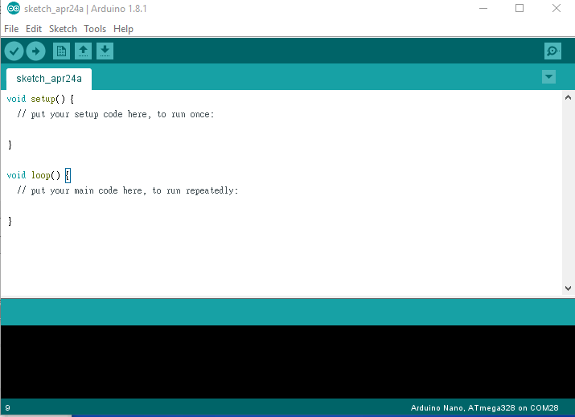
SVII – C Arduino Configuration
In general I try to keep a copy of arduino IDE installed on all the raspberry PIs I provide but if for some reason you don’t have it you can download the arm version from:
https://www.arduino.cc/en/Main/Software
Since this is a raspberry PI you want the Linux ARM version (not 32 or 64 bit ones)
To run the IDE for arduino you need super user permissions:
/home/pi/Arduino/$ sudo ./arduino
If you run it correct the IDE should pop
up.
Load the firmware .ino file for the SVII from
the SVII_R8 package
?/SVII_R8/FIRMWARE/spectrochip_SVII_R8/spectrochip_SVII_R8.ino
16
Version 1.00
Adrian Tang © UCLA/JPL 2018

Slide 17
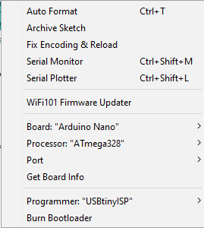
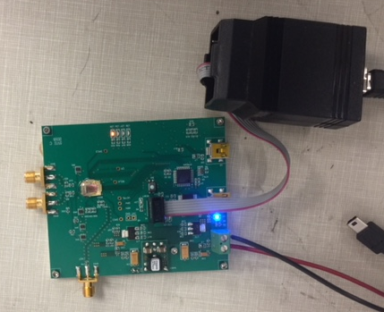
SVII – C Arduino Configuration
There are two steps, first putting the bootloader (underlying OS) on the board, then putting on the actual firmware.
To load the ardunio bootloader you need an USBtiny ISP programmer. If you don’t have one you can buy it from adafruit here: https://www.adafruit.com/product/46
To setup the programmer go to “tools” menu
Board: Arduino Nano
Processor: Atmega328P
Port: /dev/ttyUSBx (where x could be 0 or 1 or 2)
Apply the 5V power to the PCB and connect
the ISP header from the programmer noting
the orientation of Pin 1.
Goto “tools” and click “burn bootloader” right
at the bottom. The leds should all flicker and
after a few seconds the IDE should report
“burn bootloader done”
There should only be a single blinking orange LED on the SVII board
if the bootloader was put on successfully.
17
Version 1.00
Adrian Tang © UCLA/JPL 2018

Slide 18
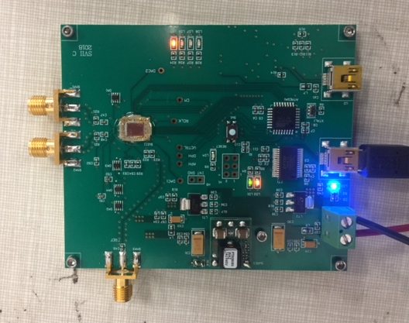
SVII – C Arduino Configuration
Next we need to load the actual firmware that drives the spectrometer.
Again make sure you have spectrochip_SVII_R8.ino loaded
Apply the 5V power to the PCB and connect a USB to the data-port only
Confirm setup the programmer go to “tools” menu
Board: Arduino Nano
Processor: Atmega328P
Port: /dev/ttyUSBx (where x could be 0 or 1 or 2)
Click the program button
After a few seconds of compiling both the orange and green lights should come on as the program downloads.
After this it should report “programming done” and now the board is fully configured.
Green + Orange (Program is going in okay)
18
Version 1.00
Adrian Tang © UCLA/JPL 2018

Slide 19
SVII Basic Interface and Drivers
Rasp PI 3
SVII Board
HOST PI3
FTDI VCP Driver
Control USB
Atmel 328
Processor
(Arduino)
USART
SVII
(ascii characters)
sequence pins
readout
USB D2xx
Driver
FT23H
USB Packets
asynchronous
8 bit
WR/TXE
The SVII control port is an arduino-compatible port that is driven by a virtual com port (VCP) driver on the host computer. Commands are sent via simple ascii characters to initiate complex functions on the atmel processor.
The arduino atmel processor talks to the SVII via USART for configuration and sequence pins for timing.
The readout is a low level USB interface that talks directly to the host via USB packets. The USB socket and endpoint is managed by the D2xx series driver .
19
Version 1.00
Adrian Tang © UCLA/JPL 2018

Slide 20
SVII Linux Environment
Linux Environment Setup Details
The PI software is open source but it has some dependencies on other open source libraries. If you have a fresh install of Raspbian or Ubuntu on the PI you will need to get a few libraries to run the spectrometer:
We use the WiringPi library. Install instructions are here (http://wiringpi.com/download-and-install/)
We also use the GNUplot utility which is not standard with linux. You need to run
sudo apt-get install gnuplot-x11
We draw on GTK and other environments so after you do this stuff make sure your linux is the latest by running the commands:
sudo apt-get update
&
sudo apt-get upgrade
20
Version 1.00
Adrian Tang © UCLA/JPL 2018

Slide 21
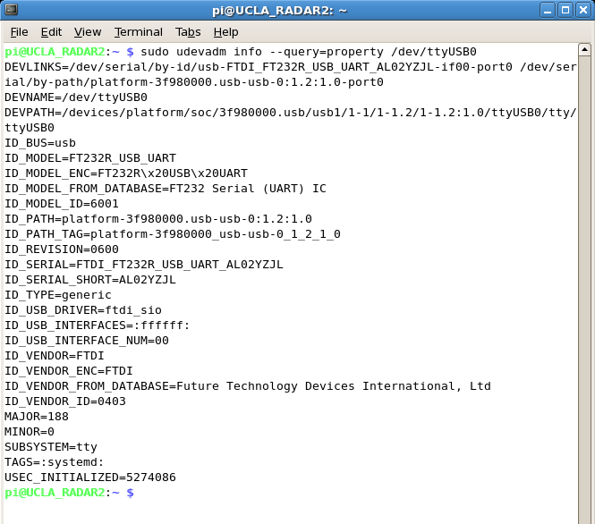
SVII Udev Configuration
Okay so the issue is the linux kernel USB driver sucks. This part is a bit complicated.
Background:
When you plug in a USB device it enumerates them /dev/ttyUSB0 then /dev/ttyUSB1 then /dev/ttyUSB2 and so on. The problem is it does this in the order that things are plugged in. When the PI first boots it does this in a random order for each device connected. The problem is the spectrometer has 2 dedicated USB ports, one for data and one for control that are not interchangeable. So every-time you reboot, sometimes ttyUSB0 is data, and sometimes it’s the control port. This obviously won’t work because the software would get confused so we use serial numbers instead of USB port #s to manage the spectrometer connections (especially in our multi-pixel instruments).
To get the serial number of a given usb device the command is
sudo udevadm info –query=property /dev/ttyUSB0
which gives you something like this:
The line that says ID_USB_SERIAL_SHORT is the serial number of the USB device. In this case it’s AL02YZ3L.
21
Version 1.00
Adrian Tang © UCLA/JPL 2018

Slide 22
SVII Udev Configuration
There are a few things to know here before we get into it.
The way the FTDI chips work: the control port works using a virtual com serial port (VCP) where you send and receive ASCII commands to configure the SVII chip and perform functions. Alternatively the high speed data port uses low level FT drivers to do the communications. The difficulty is that Linux automatically loads the virtual com port driver onto both ports when you plug them in. Once the VCP driver controls the USB endpoint socket number, the low level FT drivers (like D2x) can’t load on top of it for the same socketID.
The goal is to therefore apply a patch to the kernel (called a hook) that senses the USB serial number associated with each port (data, control) and automatically unloads the VCP driver for the data port.
This is done with a kernel extension called usb rules, found in /etc/udev/rules.d/ on most linux systems. Any “rule files” you place in here will automatically be run each time the USB state changes (something is plugged in or out).
Secondly in a multi-pixel system it’s nice to give each pixel a unique name instead of just calling them ttyUSB0, ttyUSB1, … and so on. To do this we add a second kernel hook that drops symbolic links to specific spectrometers whenever they are plugged into the computer.
22
Version 1.00
Adrian Tang © UCLA/JPL 2018

Slide 23
SVII Udev Configuration
So the steps we need to do are
Figure out the serial address of the data port of the part you’re holding
Figure out the serial address of the control port of the part you’re holding
Apply the hook to prevent the driver for loading on the data port.
So what we do first is
Plug in the control port.
/dev/ttyUSB0 should now show up
Run the command sudo udevadm info –query=property /dev/ttyUSB0
Note the Serial number of the control port AXXXXXX or whatever it is
Plug in the data port
/dev/ttyUSB1 should now show up
Run the command sudo udevadm info –query=property /dev/ttyUSB1
Note the Serial number of data port.
Now we can create the rules file we need for the kernel to do the right things
There may or may not be a rules file on the system. If there is not make a new one
/etc/udev/rules.d/10-ftdi-rules
and inside put the following lines
ATTRS{serial}=="AI04YFRB", SYMLINK+="tty_SVII_1“
ATTRS{serial}=="FT2ZJNMJ", RUN+="/bin/sh -c 'echo $kernel > /sys/bus/usb/drivers/ftdi_sio/unbind'"
The top line adds the symbolic link to “tty_SVII_1” to the /dev/ttyUSB that has the specified serial number. In this one you should put the serial number of your control port on the spectrometer. The second line is the command to unload the linux VCP driver for the data port so we can use the low level drivers on the socketID. Put the serial number for the data port here. Note that once the driver is unloaded for the data port you won’t be able to talk to itfrom the kernel anymore (IE the sudo udevadm info won’t work for the data port).
Once you save those changes you need to tell the kernel to activate them:
sudo udevadm control –reload-rules
23
Version 1.00
Adrian Tang © UCLA/JPL 2018

Slide 24
SVII Udev Configuration
Then run
sudo udevadm trigger
to trigger a USB event that causes the rules to be evaluated.
If this is done right then in your /dev directory there should be
/dev/tty_SVII_1
and either a /dev/ttyUSB0 or /devttyUSB1 but only 1 of them. Even with the symbolic link the kernel still makes the random ttyUSB link but we don’t use it since it’s randomly assigned. Past that there should only be 1 ttyUSB listed since we unloaded the driver for the other port. If you see 2 ttyUSBs on the list it means either the serial number or something else isn’t correct in the rules file.
So the idea of the symbolic link is if you had a 10 pixel system you can name the spectrometers
/dev/tty_SVII_pixel1
/dev/tty_SVII_pixel2
/dev/tty_SVII_pixel3
/dev/tty_SVII_pixel4
/dev/tty_SVII_pixel5
…
This way regardless of what order you turn them on, the pixel link will always point to the right receiver pixel because it’s bound by the physical serial number of the part.
24
Version 1.00
Adrian Tang © UCLA/JPL 2018

Slide 25
SVII Release 8 Software
In SVII release 8 we have several useful utilities, most of them for calibration related tasks as well as multiple configuration files.
SVII_cal performs detailed timing analysis on the spectrometer and adjusts the internal clock settings (many) to find the best possible configuration. The utility optionally burns that configuration onto the PCB EEPROM so it’s saved. Note the settings for full speed, half speed and quarter speed clocks are saved into different EEPROM addresses so that you can have an optimal calibration for each. This utility reads a cal_xxx file
SVII_align performs the coarse clock alignment with the phase shifters and reports back the clock settings. As long as it’s all not 0 or 255 it should be okay.
SVII_analog performs the ADC analog alignment and reports back. THA should be 30-50 range, CM/PRE should be under 200.
SVII_lock automatically adjusts the internal synthesizer tuning and reports back. Anything that’s not 15 is good.
SVII captures a spectrum a set number of times and saves it to a file
The folder contains make files and source for each utility
25
Version 1.00
Adrian Tang © UCLA/JPL 2018

Slide 26
SVII Calibration Configuration File
The calibration utilities are all controlled by a cal.usb file with several important parameters
[Spectrometer control]/[spectrometer data]
The Spectrometer control sets the serial number and logical path to the control port. The data sets the serial number of the data port to look fore with the low level d2x type drivers
[Averaging ] is in the format A B C D E and sets the amount of per cycle averaging
The chip will average
A*256^3 + B * 256^2 + C * 256 + D times
per acquisition cycle, then the software will repeat that acquisition E times.
(cal_clk0.usb)
--------------------------------------------------------
[Spectrometer0_Control]
AI04ZDG5
/dev/tty_SVII_1
[Spectrometer_data]
FT35V5MS
[AVERAGING_AND_ITERATIONS]
0 4 0 10 2
[RANGE]
1E11
[DATA]
./SVII_clk0.cal
[WIN_ENABLE]
1
[CLOCK_SETTING]
0
[TRIM_CHECK]
0
[READOUT_PRESCALE]
4
[DEBUG]
0
[CAL_RANGE_MIN]
2000
[CAL_RANGE_MAX]
4090
END
--------------------------------------------------------
26
Version 1.00
Adrian Tang © UCLA/JPL 2018

Slide 27
SVII Calibration Configuration File
[Range ] is a legacy thing. Don’t touch it
[DATA ] is the file path any cal data is dumped to
[WIN_ENABLE ] turns on and off the hanning window at the input of the FFT processor
(0=disable, 1=enable)
[CLOCK SETTING ] Sets the main speed of the SVII chip
0 = 3.0 GHz bandwidth
1 = 1.5 GHz bandwidth
2 = 0.75 GHz bandwidth
Note the calibration is only performed for the clock speed set. So if you want to perform it for all 3 clock settings you need to edit this and run the cal times (or have 3 config files like me… cal_clk0, cal_clk1, cal_clk2)
(cal_clk0.usb)
--------------------------------------------------------
[Spectrometer0_Control]
AI04ZDG5
/dev/tty_SVII_1
[Spectrometer_data]
FT35V5MS
[AVERAGING_AND_ITERATIONS]
0 4 0 10 2
[RANGE]
1E11
[DATA]
./SVII_clk0.cal
[WIN_ENABLE]
1
[CLOCK_SETTING]
0
[TRIM_CHECK]
0
[READOUT_PRESCALE]
4
[DEBUG]
0
[CAL_RANGE_MIN]
2000
[CAL_RANGE_MAX]
4090
END
--------------------------------------------------------
27
Version 1.00
Adrian Tang © UCLA/JPL 2018

Slide 28
SVII Calibration Configuration File
[Trim Check ] is a legacy thing. Don’t touch it
[Readout Prescale] Sets the clock speed of the readout.
0 is 700 Kb/s
1 is 1400 Kb/s
2 is 3200 Kb/s
3 is 5000 Kb/s
4 is 10000 Kb/s (USB 2 mode)
Faster modes work but the RPI3 USB driver only goes up to mode 4 so don’t go higher
[Debug] Turns on or off a test pattern that is FFT transformed instead of the ADC data to debug the processor core. 0 normal, 1 test mode.
(cal_clk0.usb)
--------------------------------------------------------
[Spectrometer0_Control]
AI04ZDG5
/dev/tty_SVII_1
[Spectrometer_data]
FT35V5MS
[AVERAGING_AND_ITERATIONS]
0 4 0 10 2
[RANGE]
1E11
[DATA]
./SVII_clk0.cal
[WIN_ENABLE]
1
[CLOCK_SETTING]
0
[TRIM_CHECK]
0
[READOUT_PRESCALE]
4
[DEBUG]
0
[CAL_RANGE_MIN]
2000
[CAL_RANGE_MAX]
4090
END
--------------------------------------------------------
28
Version 1.00
Adrian Tang © UCLA/JPL 2018

Slide 29
SVII Calibration Configuration File
[cal range min]/ [cal range max] this is complicated.
Sometimes there are environmental spurs or low frequency noise from power supplies that can screw up your analog/processor calibration so these settings constrain the program to only look at FFT channel numbers between these two endpoints.
This way you can avoid things that would otherwise cause your calibration not to converge.
(cal_clk0.usb)
--------------------------------------------------------
[Spectrometer0_Control]
AI04ZDG5
/dev/tty_SVII_1
[Spectrometer_data]
FT35V5MS
[AVERAGING_AND_ITERATIONS]
0 4 0 10 2
[RANGE]
1E11
[DATA]
./SVII_clk0.cal
[WIN_ENABLE]
1
[CLOCK_SETTING]
0
[TRIM_CHECK]
0
[READOUT_PRESCALE]
4
[DEBUG]
0
[CAL_RANGE_MIN]
2000
[CAL_RANGE_MAX]
4090
END
--------------------------------------------------------
29
Version 1.00
Adrian Tang © UCLA/JPL 2018

Slide 30
SVII_CAL utility
The SVII cal utility optimizes a wide range of clock settings in the chip… specifically all these ones:
//SVII Clock Control Settings
int dfine_CD = 40; // 8 bit address 3H //Sets the fine tune clock delay of ADC 2's THA and comparator
int dfine_AB = 40; // 8 bit address 4L //Sets the fine tune clock delay of ADC 1's THA and comparator
int dtune_CD = 13; // 4 bit address 4H //Sets the coarse tune clock delay of DEMUX CD (data coming from ADC 2)
int dtune_AB = 13; // 4 bit address 5L //Sets the coarse tune clock delay of DEMUX AB (data coming from ADC 1)
int retime_AB2 = 50; // 8 bit address 6L //Sets the fine tune clock delay of retimer AB stage 2
int retime_AB1 = 50; // 8 bit address 6H //Sets the fine tune clock delay of retimer AB stage 1
int retime_CD2 = 50; // 8 bit address 7L //Sets the fine tune clock delay of retimer CD stage
int retime_CD1 = 50; // 8 bit address 7H //Sets the fine tune clock delay of retimer CD stage 1
int demuxf_AB = 50; // 8 bit address 8L //Sets the fine tune clock delay of DEMUX CD (data coming from ADC 2)
int demuxf_CD = 50; // 8 bit address 8H //Sets the fine tune clock delay of DEMXU AB (data coming from ADC 1)
int dec_coarse = 15; // 5 bit address 10H //Sets the coarse tune clock delay of decoder //default 15
int dec_fine = 50; // 8 bit address 11L //Sets the fine tune clock delay of decoder /default 50
To launch it you need super user permissions
/SVII_R8/sudo ./SVII_cal cal_clk0.usb
The program flow is to first
Calibrate the internal synthesizer with the phase lock routine
Calibrate the coarse clock alignment with phase detectors
Calibrate the analog conditions of the ADC
Once that’s done it will adjust the knobs above to produce the smoothest spectrum between the channels specified in the config file (spurs are the symptom of a timing error)
30
Version 1.00
Adrian Tang © UCLA/JPL 2018

Slide 31
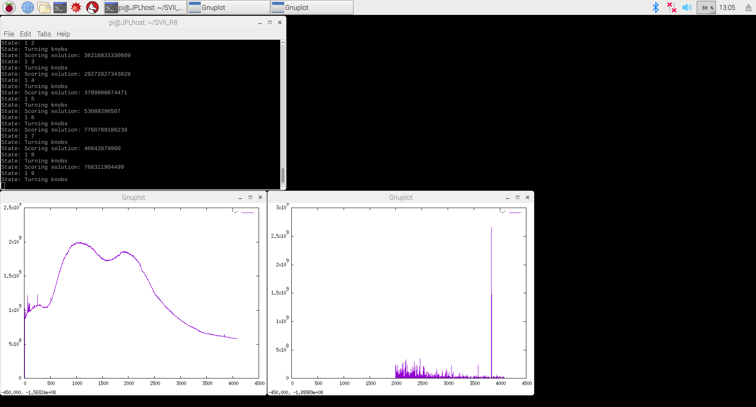
SVII_CAL utility
This is the SVII_cal interface which shows a graph of the
current spectrum and a graph of the second derivative
squared of that spectrum as a spur detector, but only
between the channel range specified.
It then adjusts the knobs to minimize the integral of the spur detector
Function.
Note this works best with a relatively flat noise source connected to
the spectrometer input.
Automatic Search
(Scores are integral of
spur detection filter
for each clock setting)
Current Spectrum
Spur Filter
( )²
d²S(f)
df²
Range FFT channel 2000 to 4096
(avoids environmental noise)
Environmental DC noise
31
Version 1.00
Adrian Tang © UCLA/JPL 2018

Slide 32
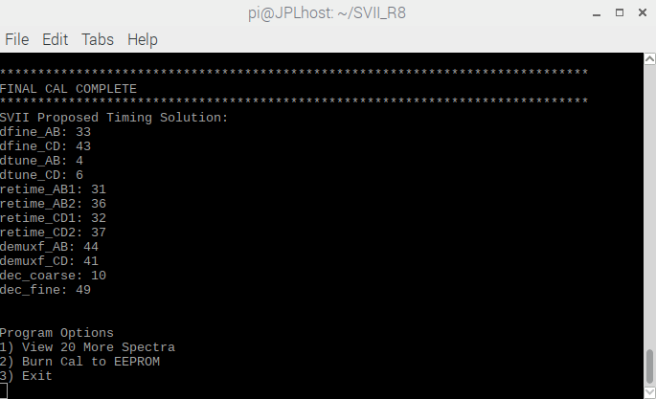
SVII_CAL utility
When the cal finishes it will show you the final timing solution.
It will give you options to just
view more spectra (doesn’t change settings).
If you are happy with the cal you can burn the solution to the EEPROM on the PCB so it loads automatically when the acquire program (SVII) is run.
Note cals are stored separately in the EEPROM depending on the clock setting. If you cal clock-select 0 (3 GHz) the other settings (1.5GHz and 0.75 GHz) remain un-calibrated. You need to run it 3 times with each clock_select setting and save to cover all the possibilities.
selecting 3 exits the program. Also note the EEPROM is only good for 1000 writes!
32
Version 1.00
Adrian Tang © UCLA/JPL 2018

Slide 33
SVII_lock utility
The frequency synthesizer inside the SVII has an LC VCO that has a switched capacitor bank (100ff,200ff,400ff,800ff,1600ff) so that the frequency lock range of the synthesizer can be adjusted.
The SVII_lock utility sweeps the capacitor setting (from 0 to 15) and looks at the control voltage of the PLL loop with the arduino ADC to find the capacitor setting (if any) that locks to the input clock frequency (normally 23.4375 MHz).
If it detects a lock it will return to that capacitor setting (0 to 15) and leave the chip in the locked state. If not it will just leave the setting at 15 when the sweep ends.
This runs inside the SVII_cal utility and SVII capture utility before the calibration or acquisition is performed.
To launch it you need super user permissions
/SVII_R8/sudo ./SVII_lock cal_clk0.usb
33
Version 1.00
Adrian Tang © UCLA/JPL 2018

Slide 34
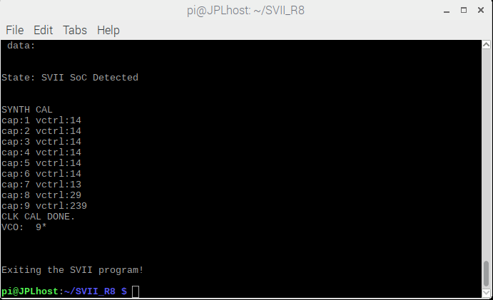
SVII_lock utility
Locked is defined as: 20<vctrl<320
In this case it locked on capacitor setting #9
If it returns VCO: 15 then something is wrong
with the clock setup.
34
Version 1.00
Adrian Tang © UCLA/JPL 2018

Slide 35
SVII_align utility
This program looks at the phase detector between the two interleaved ADC channels and sweeps the main ADC clock phase settings from 0 to 63 each.
delayA delayAN delayB and delayBN.
It seeks out where the phase detector shows a 180 degree clock relationship. Since the phase-to-voltage is a bit noisy it shape-fits to a Gaussian across the entire sweep to pick the optimal setting. The utility notes the left and right 3dB point of the gaussian fit as well as what setting it determines to be in the middle
To launch it you need super user permissions
/SVII_R8/sudo ./SVII_align cal_clk0.usb
35
Version 1.00
Adrian Tang © UCLA/JPL 2018

Slide 36
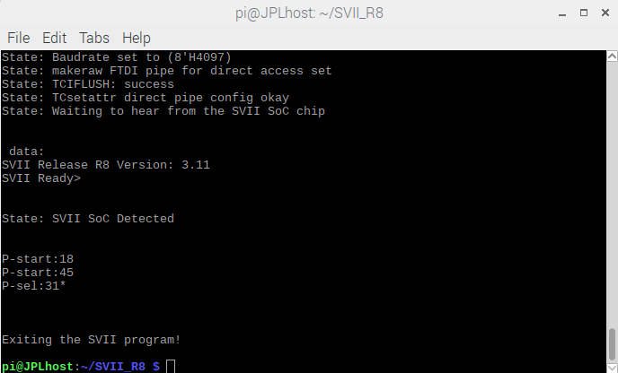
SVII_align utility
Main phase tuners go from 0 to 63 (0 to 2pi)
Nominal is 32 (180 deg is pi).
Here we arrived at 31. Also shown are the
Gaussian fit 3dB Points 18 and 45.
If P_sel isn’t like 20-40 range something's
wrong.
36
Version 1.00
Adrian Tang © UCLA/JPL 2018

Slide 37
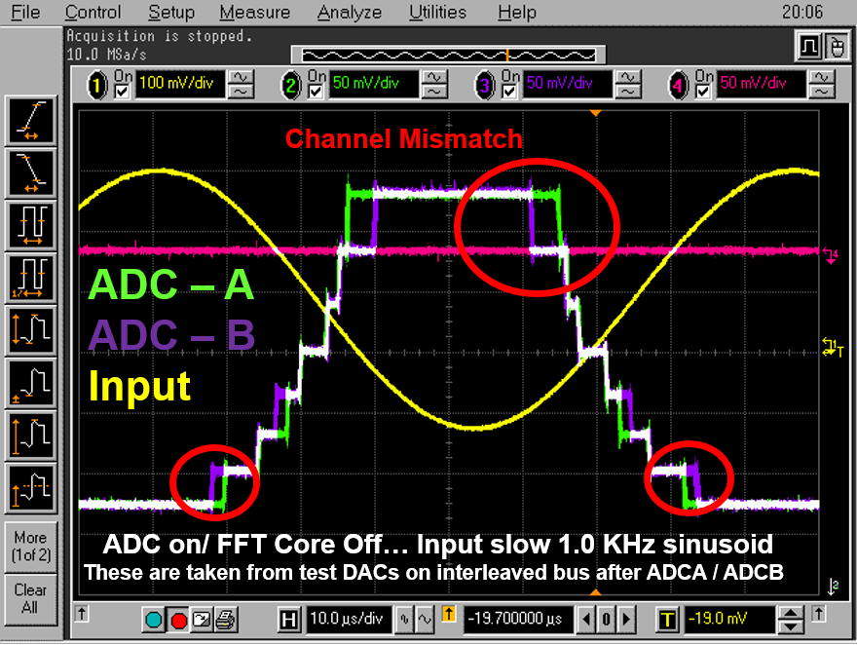
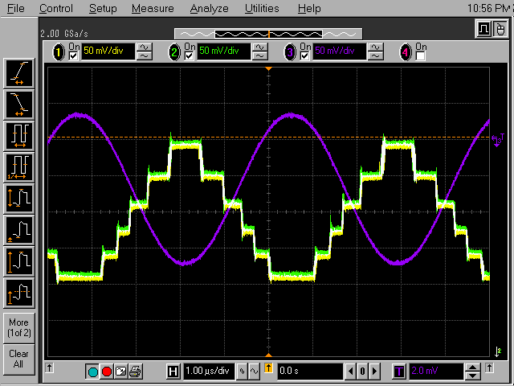
SVII_analog utility
This program looks at the ADC analog configuration and adjusts the DC bias conditions of each stage (preamp, track and hold) based on sensing of replica ADC outside the signal path. It then reports back the settings it chose.
ADC Before Self-Calibration
ADC After Self-Calibration
Replica Calibration Off
Replica Calibration On
A&B Well Matched
*Observed from DAC-C/D testpoint
37
Version 1.00
Adrian Tang © UCLA/JPL 2018

Slide 38
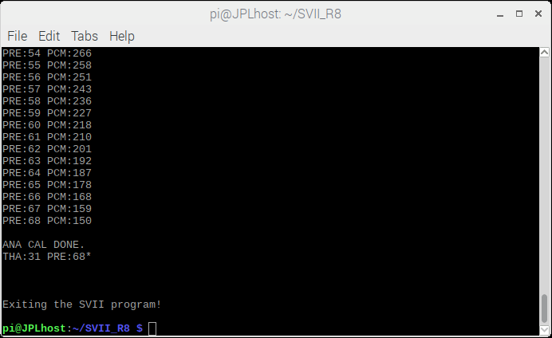
SVII_analog utility
To launch it you need super user permissions
/SVII_R8/sudo ./SVII_analog cal_clk0.usb
Shows the final ADC calibration result.
THA is designed to be 20-50
PREamp in the range of 30-90 is okay
38
Version 1.00
Adrian Tang © UCLA/JPL 2018

Slide 39
SVII acquisition program
This acquisition program “SVII” captures data a set number of averaging times and dumps it to a specified data file. SVII reads a configuration script similar to the calibration utilities (all the fields are the same except there is no start and end range specified)
run_clk0.usb
-----------------------------------
[Spectrometer0_Control]
AI04ZDG5
/dev/tty_SVII_1
[Spectrometer_data]
FT35V5MS
[AVERAGING]
0 14 0 10 1000
[RANGE]
1E11
[DATA]
./SVII_data.csv
[WIN_ENABLE]
1
[CLOCK_SETTING]
0
[TRIM_CHECK]
0
[READOUT_PRESCALE]
4
[DEBUG]
0
END
To launch it you need super user permissions
/SVII_R8/sudo ./SVII run_clk0.usb
NOTE YOU NEED A CAL ALREADY SAVED ON THE EEPROM FOR THE CLOCK SETTING YOU’RE USING IN THE ACQUSITION OTHERWISE IT WILL LOAD GARBAGE SETTINGS AND NOT WORK AT ALL!
39
Version 1.00
Adrian Tang © UCLA/JPL 2018

Slide 40
Final Thoughts
In general the calibration works well but it depends how flat your input band of the noise source you’re using to calibrate is and how many environmental spurs there are. Cal is not a direct process and often you need to play with the channel range and averaging time to get it to work well for a given part. In general the 3GHz mode seems the easiest to calibrate and the lower frequency ones are more difficult.
All the other cals (analog, align, lock) are inside the SVII_cal program so you should just have to run that one if you need a new cal. The other utilites are more for troubleshooting tools.
40
Version 1.00
Adrian Tang © UCLA/JPL 2018

